Slide 1
Team
Now In Orbit
NASA Space Apps Challenge 2022

Slide 2


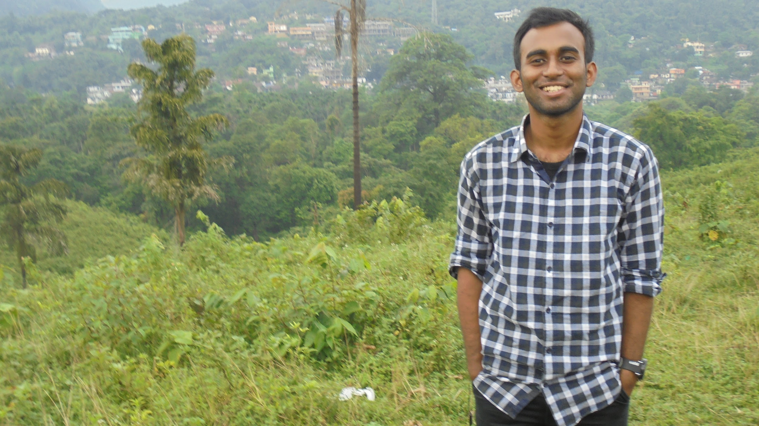


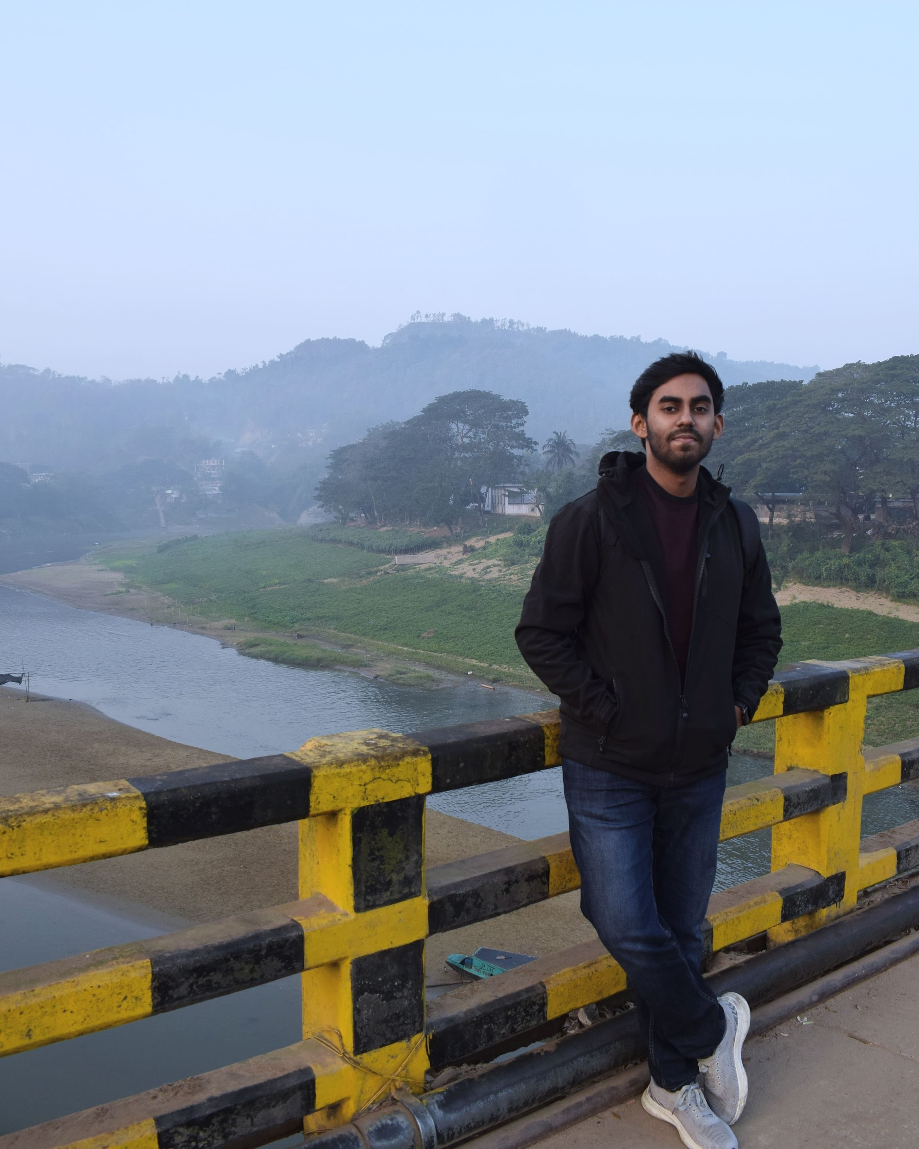
Team Introduction
Team Now In Orbit consists of five undergraduate students from BRAC University. We are a part of the current team of BRACU Mongol Tori which is a mars rover. We have also participated in 3rd Kibo RPC 2022 and secured the Second Runner Up position in Bangladesh.
Suhail Haque Rafi
Mazharul Islam Rakib
Mir Muhammad Fuad
Mahinoor Rahman
Fahim Sultan Anoy

Slide 3
Topic Selection & Goal for this Challenge
The topic that we finalized for the NASA Space Apps 2022 Challenge is “INSAR CHANGE DETECTIVES” where the challenge is to come up with an algorithm to remove the tropospheric signal from various radar datasets and discerning the real ground motion as earth scientists uses radar signals to observe small deformations of earth’s surface but the interaction with tropospheric water vapour slows down the radar signal and the ground seems to be moving.

Slide 4
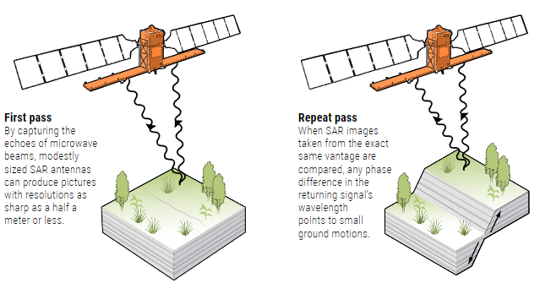
What is INSAR?
Interferometric synthetic aperture radar (InSAR) is ideally suited to measure the spatial extent and magnitude of surface deformation associated with fluid extraction and natural hazards (earthquakes, volcanoes, landslides). It is an effective way to measure changes in land surface altitude. InSAR makes high-density measurements over large areas by using radar signals from Earth-orbiting satellites to measure changes in land-surface altitude at high degrees of measurement resolution and spatial detail.
InSAR was first demonstrated more than 30 years ago, is reaching its heyday. By comparing radar imagery gathered over time, researchers can detect ground motions as small as a few millimeters.

Slide 5
An overview of SAR
SYNTHETIC APERTURE RADAR, the "SAR" on which InSAR depends, originated in the 1950s as a tool for airborne military reconnaissance. Like traditional radar, SAR instruments captured images of the planet by sending out microwave pulses and recording the echoes. And like a traditional radar, the instruments could penetrate clouds and worked equally well at night. A key difference was the "synthetic" aspect of SAR. Larger radar antennas, like larger apertures on a camera, collect more of the echoes and enable sharper pictures. But building a single antenna large enough to take a high-resolution image isn't practical. Researchers realized they could instead create an artificially large aperture by combining the signals received on a much smaller antenna as it moved through space.
Today, SAR satellites with antennas just a few meters across can produce images with pixel resolutions as sharp as half a meter—better than many satellite-borne cameras.
SAR images, on their own, suffice for many types of surveillance, from counterterrorism to tracking oil spills in the ocean.

Slide 6
How INSAR can replace SAR?
INSAR looks for the differences between multiple SAR images. The technique takes advantage of phase information in the returning microwaves—in other words, where a signal is in its sinusoidal path when it hits the antenna. Any phase difference in the signal between SAR images taken from the same position at different times means the round-trip distance has changed, and can reveal surface movements down to a few millimeters.
"There's nothing else that compares to it," says Michelle Sneed, a hydrologist at the U.S. Geological Survey. "I'm still amazed by it after a couple of decades."

Slide 7
Demerits of tropospheric Signal
About 75–80% of the mass of the atmosphere is contained in the troposphere. This layer is where almost all weather actually occurs. Rising levels of water vapor in the upper troposphere is a key amplifier of global warming.
Water vapor, which makes up up to 1% of the air in the troposphere, fluctuates geographically and rapidly depletes with altitude. Radar signals are slowed down when they come into contact with tropospheric water vapor. Sometimes the earth appears to be moving while the reading is off.

Slide 8
Necessity of removing other radiations
Removing other factors and radiations from the InSAR dataset will help us finding the clean InSAR data which will lead to a clearer training of the dataset. As a result we can get rid of the fluctuations of data due to water vapour and the actual surface deformation.

Slide 9
Our Idea
Our initial idea is to integrate data filtering algorithms into the dataset so that we can separate the radiations and tropospheric factor. As a result we can find out the clean data from our InSAR dataset.
Our technique involves a nonlinear filter that separates the interferogram into two components: one containing the smooth (low frequency) part and the other containing the detail (high frequency) part. The smooth part is obtained using a combination of a median filter and a smoothing filter. The detail component is obtained by subtracting the smooth component from the original signal. This detail component is filtered to remove noise and then added to the smooth component to generate the final output.

Slide 10
About the filters
Goldstein Filter:
The Goldstein filter is implemented in the frequency domain. It smoothes the spectrum |Z(u, v)| in each segmented patch by spatial convolution with a block kernel S{·}, and then multiplies the smoothed spectrum by the 2D FFT samples Z(u, v):
Z(u,v) = S{|Z(u,v)|}^α.Z(u,v)
The filter parameter α is an arbitrary value that typically lies in the range of [0, 1].
For the case =0, the smoothing operator equals one, and there is no filtering.
When the larger value of α is chosen, the filtering becomes more significant,
and for the value of α = 1, the strongest filtering occurs.
[Here α is the filter parameter; u and v are spatial frequencies; Z(u,v) is the spectrum of the smoothed Fourier samples]

Slide 11
About the filters
Boxcar filtering:
Boxcar filter is a kind of moving average filter, which means moving average to get variation of the trend. The result of the filter matches the value of the two-dimensional multiplication in the spectral domain.
The characteristics of the moving average improve that the simple average can mislead the prediction of the change of the data, and the smoothing effect of the data is utilized to soften the data when the change-motion is severe.
but in a region with high slope, the value is unstable due to Noise-Propagation. The advantage of the Boxcar filter is that, unlike the Goldstein algorithm, noise propagation occurs, but all pixel information is available.

Slide 12
Impact of our idea
As the effects of water vapor in the atmosphere and the spatial-temporal decorrelation, the interferometric phase is always very noisy. If the noise was not properly removed, it will not only affect the quality of the elevation or deformation measurements derived from the interferogram, but also bring pseudo residues that interfere with the phase-unwrapping process.

Slide 13
Thank You

